Slide 1


AURORA Authorized User Recognition for Operational Residential Automation
Notes:
https://unsplash.com/photos/glass-window-building-vLN225oj0ck

Slide 2
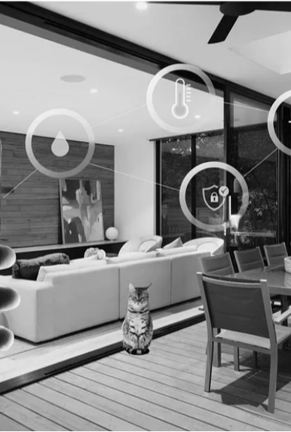
Introduction
Home automation refers to the use of technology to control home functions and features automatically. It includes systems that manage lighting, heating, security, and appliances etc.
Why Voice Identification?
Introduce voice identification as a solution that offers both security and personalized control. Only registered voices can activate the system, ensuring that commands are executed by authorized users.
Notes:
https://unsplash.com/photos/architectural-photography-of-black-and-brown-hallway-ZtC4_rPCRXA

Slide 3
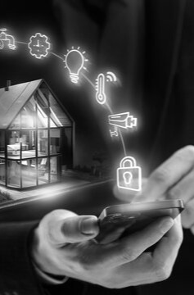
How Voice Identification Work
Voice Biometrics
Voice biometrics involves the analysis of a person's voice to recognize their identity. Each individual has a unique voiceprint, which is as distinctive as a fingerprint.
analyzes, and matches voice patterns. key technologies involved, such as machine learning algorithms, signal processing, and neural networks.
Component
Microphones.
Voice Processing Unit
Control Unit
Notes:
https://unsplash.com/photos/oval-brown-wooden-conference-table-and-chairs-inside-conference-room-GWe0dlVD9e0

Slide 4
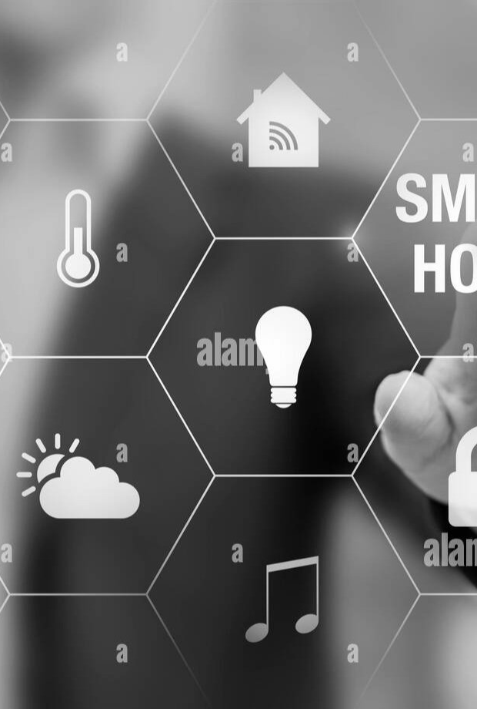
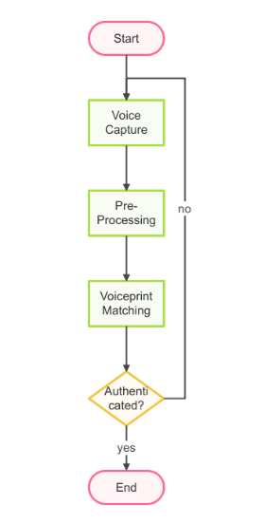
Architecture
Notes:
https://unsplash.com/photos/architectural-photography-of-black-and-brown-hallway-ZtC4_rPCRXA

Slide 5
Working Of Model
Start:
The process begins when a user issues a voice command.
Voice Capture:
The system captures the user's voice via a microphone.
Pre-Processing:
The captured voice is filtered and processed to enhance clarity and remove noise.
Voiceprint Matching:
The processed voice is compared against stored voiceprints in the database.
Authentication:
If Authenticated: The system confirms the user’s identity.
If Not Authenticated: The system rejects the command.
Command Execution:
For authenticated users, the system executes the command (e.g., controlling lights, temperature).
Feedback:
The system provides feedback to the user, confirming command execution or rejection.
End:
The process concludes, ready for the next command

Slide 6
Advantages
Enhanced Security
Exclusive Access: Only registered users can control the system, reducing the risk of unauthorized access.
Real-Time Verification: The system instantly verifies the voice before executing any command, ensuring real-time security.
Personalized Experience
User-Specific Profiles: The system can tailor responses and actions based on individual user preferences, such as setting the preferred room temperature.
Multiple Users: Different users in the household can have their preferences stored and recognized.
Convenience
Hands-Free Operation: Voice commands allow users to control the system without needing physical interaction, ideal for when their hands are occupied.
Ease of Use: The system is user-friendly, requiring minimal setup and operation.

Slide 7

Challenges
Technical Challenges
Voice Recognition Accuracy: Discuss factors that can affect recognition accuracy, such as background noise, accents, and voice changes due to illness.
System Reliability: Address the importance of maintaining a robust system that can handle multiple users and commands without failure.
User Privacy Concerns
Data Security: Highlight the importance of securing voice data and maintaining user privacy.
User Consent: Discuss the need for clear user consent when storing and using voice data.

Slide 8





Future Scope
Predictive automation
Multi-User support
Adaptive Learning
Customization

Slide 9
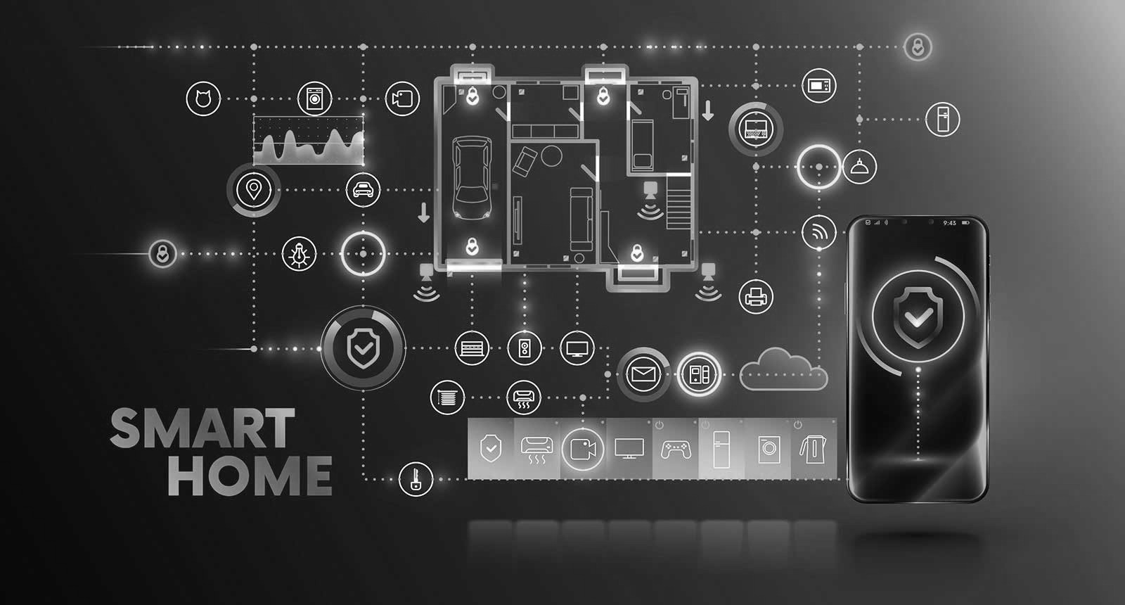
Conclusion
Summary
The integration of voice identification in home automation enhances security, personalizes user experiences, and offers a convenient, hands-free control system.
Call to Action
Encourage the audience to consider implementing voice identification in their home automation systems to achieve a higher level of security and personalized control.

Slide 10
Project Partners
Ayush Soni
Sachin Dev Das
Karan
Abhinav Bhatti
Tushar Rana
Rishi Pathak

Slide 11
THANK YOU
Any Question?.....

